Slide 1


Thunder Chickens
CSE 2410 : Introduction to Software Engineering
Final Group Presentation
Austin Haggard
Ahmad Hijazi
Abdullah Alsaraf
Abhijay Mahajan

Slide 2
Team Description
Our team consisted of two Computer Engineering majors and two Computer Science majors respectively.
Our team has a wealth/mixture of skills and abilities.
Although we fixed 5 features/bugs, we continued to work on a few additional bugs/features.

Slide 3
Project Description
Worked on Pidgin, a popular instant messaging program.
Our group worked on a mix of bugs and feature requests on the existing Pidgin open source code.
Pidgin is an instant messaging program written in C/C++.
The source code is free to download at anyones leisure.

Slide 4
Problems of the project
The source code contained no comments whatsoever, a bad practice of coding.
Project compiles easiest on Linux, we all had to switch.
Little description of what each program segment did what to the overall Pidgin application.
Some people in the team were more experienced in C++ compared to others (Because they just started learning about it.)
The program had significant maintainability issues.
Some parts of the program were clearly added as a final thought which meant they were written without future maintainability in mind, making them impossible to modify without making a huge impact.

Slide 5
Management Issues
-Didn’t use branches
-Collaborated through text message

Slide 6
Maintainability Issues
Comments not very helpful.
The need to adapt more features/bugs.
Using git was a struggle.
Examples:
gtkaccount.c line 457
/* cringe */
dialog->login_frame=gtk_widget_get_parent(gtk_widget_get_parent(frame));
gtkconv.c line 1335
/* I will miss you */
purple_conversation_set_ui_ops(conv, NULL);

Slide 7
Team Meetings Summary
- Before March we didn't have any out of class meetings.
- Team meetings were mostly to check up on each other
- Would all individually work on the same bug and communicate about issues
- Team members constantly updated the wiki to provide information about issues that we faced and how we got around them. The wiki also contains a list of fixed bugs, and the code modifications that were done in detail.

Slide 8
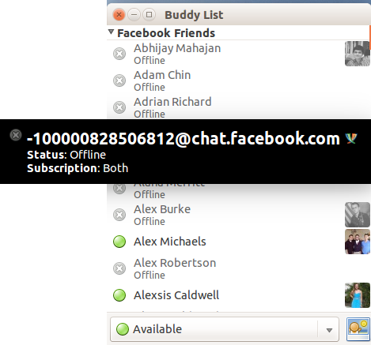
Fix #1 Odd Facebook Name Display

Slide 9
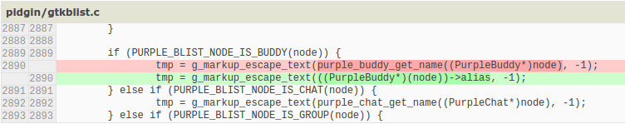
Source File Changed
gtkblist.c, 1 line changed

Slide 10
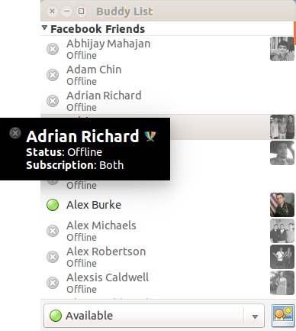
After

Slide 11
EIS/AIS
-Estimated: gtkblist.c
line 2836: create_pango_layout(const char *markup, int *width, int *height)
line 3082:pidgin_blist_create_tooltip_for_node(GtkWidget *widget, gpointer data, int *w, int *h)
line ????: gfree function (never located)
and many others before the general location was found...
-Actual: gtkblist.c
line 2866: create_tip_for_node(PurpleBlistNode *node, gboolean full)

Slide 12
Estimated Time vs. Actual Time
estimated around 3-4 hours
took about 10 hours
Simple change took a long time to locate
spent more than half the time looking in the wrong locations

Slide 13
Tests
-To reproduce we just have to mouse over a name in facebook chat.
-To verify the fix we needed to do the same thing

Slide 14
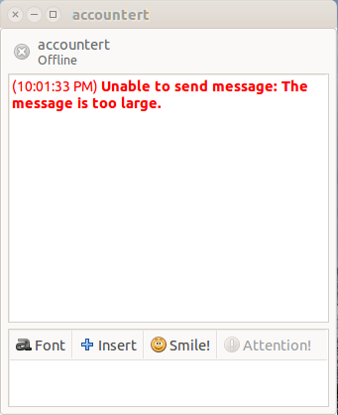
Fix #2 Long Messages Are Lost

Slide 15
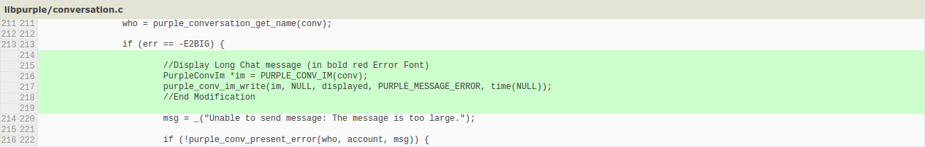
Source File Changed
coversation.c, 6 lines

Slide 16
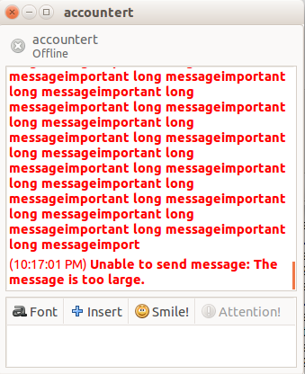
After

Slide 17
EIS/AIS
EIS:
gtkconv.c
send_cb()
conversation.c
purple_conv_send_confirm()
purple_conv_im_send_with_flags()
purple_conv_chat_send()
AIS:
conversation.c (Line 216)
common_send()

Slide 18
Estimated Time vs. Actual Time
Estimated Time: 3 hours
Actual Time: 6 hours
Most of the time was spent locating the function. After it was found, it was just a matter of knowing how to display what the user wrote and how to color it.

Slide 19
Tests
-To reproduce we have to send a long message.
-To verify the fix we needed to do the same thing and see that the text was saved and colored.

Slide 20
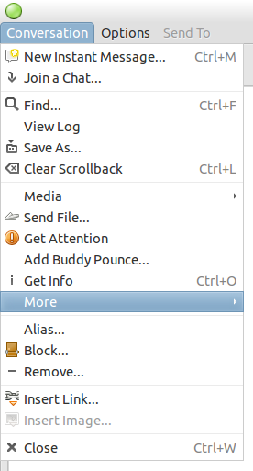
Fix #3 Text Size Shortcut

Slide 21
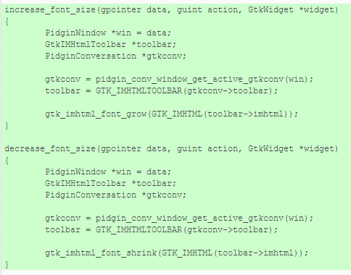
Source File Changed
gtkconv.c

Slide 22
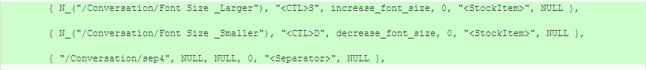
Source File Changed
gtkconv.c

Slide 23
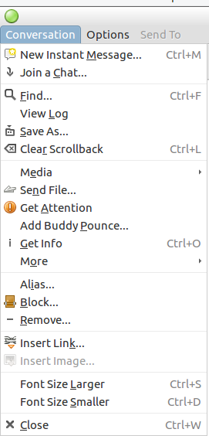
After

Slide 24
EIS/AIS
EIS:
gtkconv.c
conv_keypress_common()
entry_key_press_cb()
gtkimhtml.c
gtk_imhtml_class_init()
gtkimhtmltoolbar.c
AIS:
gtkconv.c (Lines 1203, 1216, 3156, 3158, 3160)
GtkItemFactoryEntry menu_ites[]
increase_font_size() “Created”
decrease_font_size() “Created”

Slide 25
Estimated Time vs. Actual Time
Estimated Time: 5 hours
Actual Time: 15 hours
To bind a key to a function took 2 hours or less.The rest was figuring out how to create a function that could work properly with the key. Also, knowing the functions that gtk uses to increase or decrease the size.

Slide 26
Tests
Opening a new conversation and seeing if the shortcut is added under “conversation” in the toolbar: as shown in the screenshots above.
It was verified by trying the keys and see if the size changes from small to large and the opposite.

Slide 27
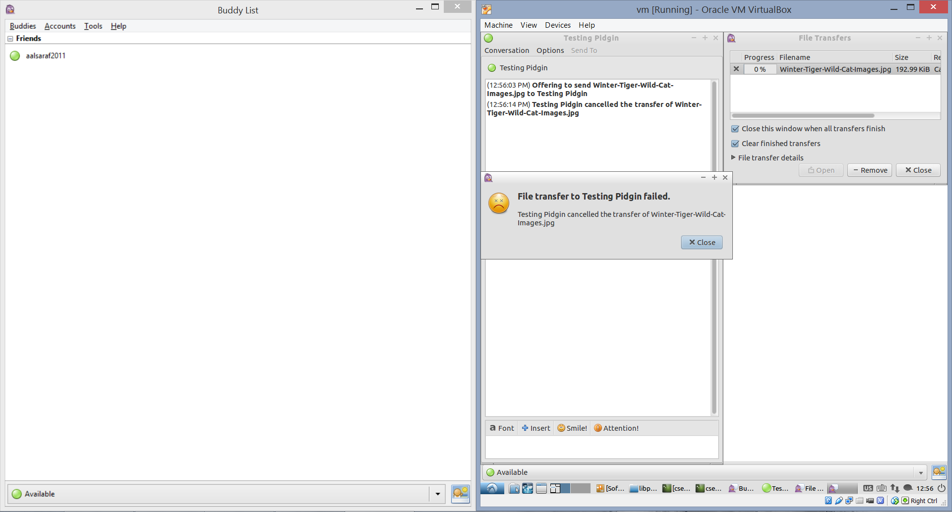
Fix #4 File Rejection Shown Twice

Slide 28
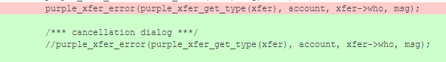
Source File Changed
ft.c, 1 line “Commented out”

Slide 29
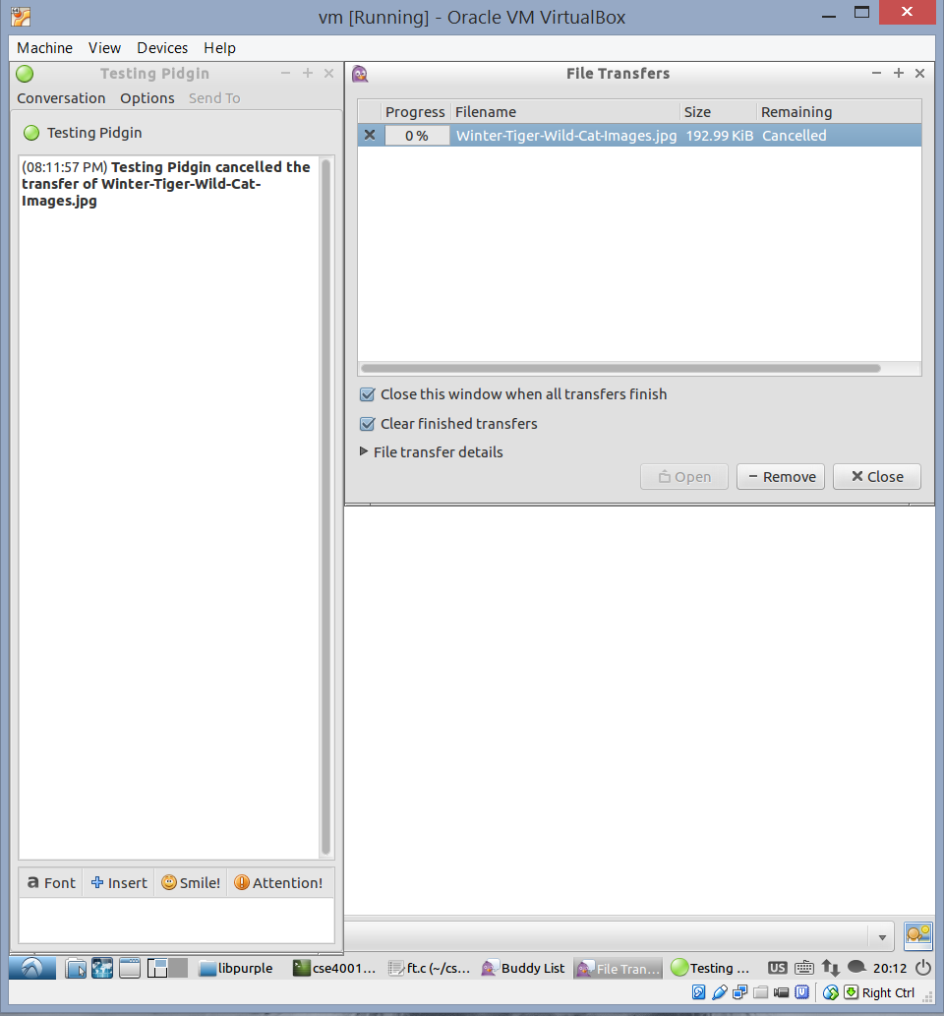
After

Slide 30
EIS/AIS
EIS:
gtkconv.c
pidginstock.c
ft.c
purple_xfer_cancel_local()
purple_xfer_is_canceled()
ask_accept_cancel()
AIS:
ft.c (Line 1596)
purple_xfer_error()

Slide 31
Estimated Time vs. Actual Time
Estimated Time: 3 hours
Actual Time: 4 hours
grep made it easy to locate the file that is responsible for remote and local cancellations. However, the file had multiple cancellation functions, so finding the error dialog took some time.

Slide 32
Tests
Testing was done on Yahoo, because AIM and some other protocols wouldn’t send files.
Two, Yahoo accounts were created for testing.
A file was sent from one account to another and then cancelled to check if the dialog still there or not.

Slide 33
Fix #5 Playing a sound on file transfer
When a user sends a file to another user, Pidgin does not give a notification sound like it does when a regular IM is sent.
This is inconvenient to users who keep Pidgin running in the background.

Slide 34
Estimated Time vs Actual Time
Estimated time: 2 - 3 Hours
Actual Time: 4 Hours ; simple fix, most of the time was spent looking through the code for needed functions

Slide 35
EIS vs AIS
EIS (6 functions):
static const struct pidgin_sound_event sounds[PURPLE_NUM_SOUNDS];
purple_prefs_add_bool
purple_prefs_add_path
purple_signal_connect
typedef enum _PurpleSoundEventID
void purple_xfer_request(PurpleXfer *xfer)
AIS (5 functions):
static const struct pidgin_sound_event sounds[PURPLE_NUM_SOUNDS];
purple_prefs_add_bool
purple_prefs_add_path
typedef enum _PurpleSoundEventID
void purple_xfer_request(PurpleXfer *xfer)

Slide 36
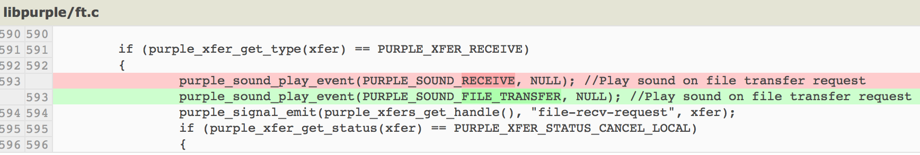
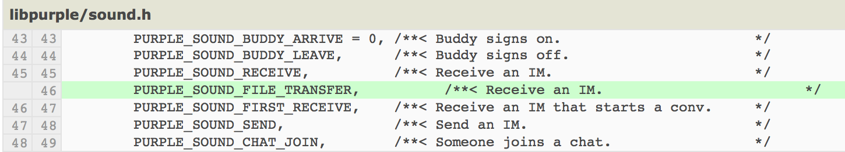
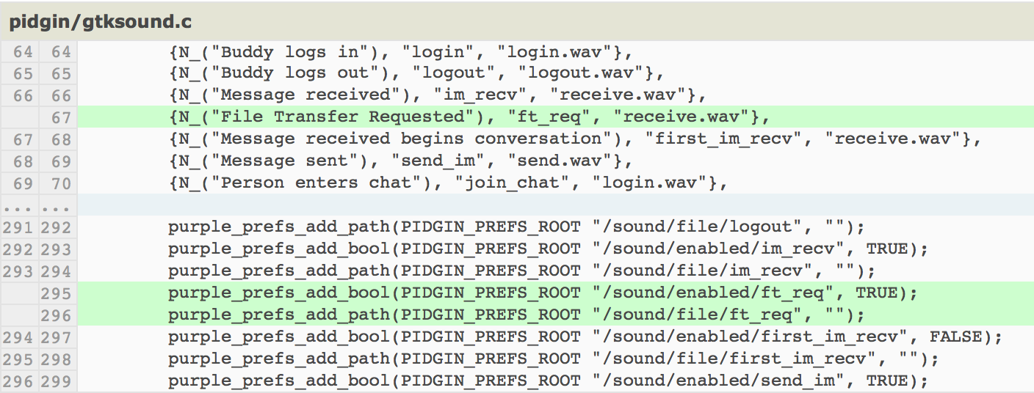
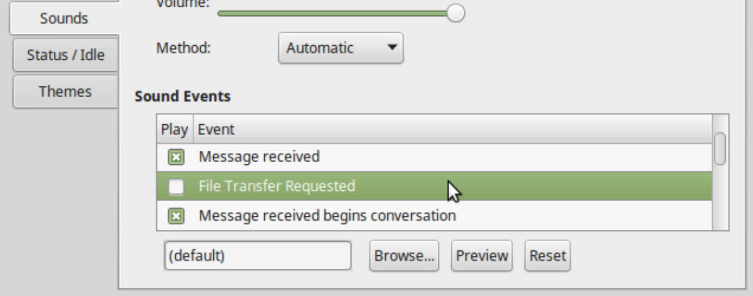
Sound activated on file transfer request
Sound function linked to event
Sound enabling/disabling added to preferences
Sound effect can be disabled from preferences.
Final fix:
6 inserted lines

Slide 37
Tests
Messages were sent from Yahoo Messenger to Pidgin to test multiple sound effects: Regular IM, <ding>, and File Transfer. File Transfer produced no sound.
After the fix, the same test was done and the sound from the File Transfer request can now be heard. Attempting to disable the sound through the preferences is also successful.

Slide 38
Fix #6 Playing a sound on call.
Whenever a user tries to call another user, no sound is played, making it very inconvenient to users who run Pidgin in the background.

Slide 39
Estimated Time vs Actual Time
Estimated time: 2 - 3 Hours
Actual Time:
Unsuccessful Fix: 9 Hours
Successful Fix: 5 Hours

Slide 40
EIS vs AIS
EIS:
gtksound.c and/or sound.h
AIS:
gtksound.c (Line 614)
sound.h (Line 55)
gtkmedia.c (Line 75 and Line 314)

Slide 41
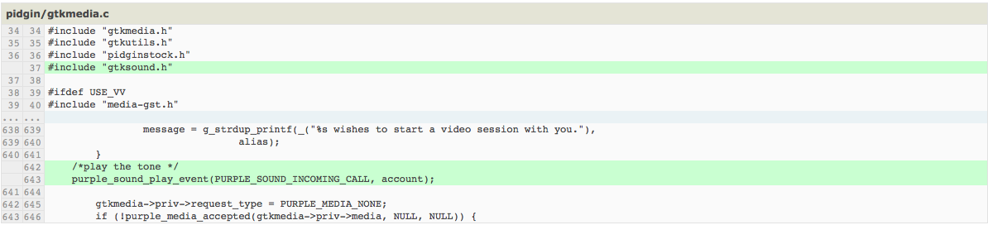
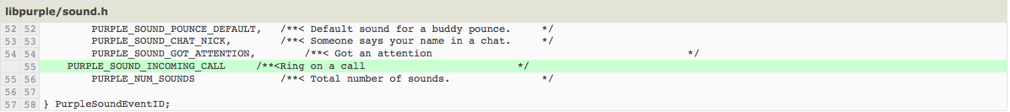
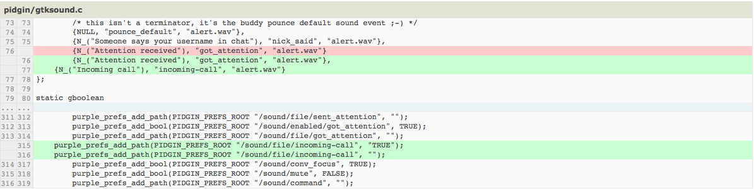

Slide 42
Tests
Had a friend create a sample account on pidgin, and I added him.
I later asked him to call me to see if there was sound being generated whenever he called. If there was no sound being generated whenever he called, that meant I may have done something wrong in my code.
However, when he did call, a sound was generated.

Slide 43
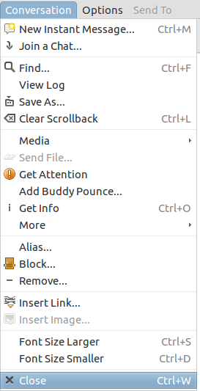
Fix #7 Chat History Shortcut.

Slide 44
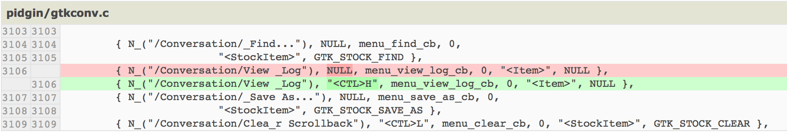
Source File Changed
gtkconv.c, 1 line modified

Slide 45
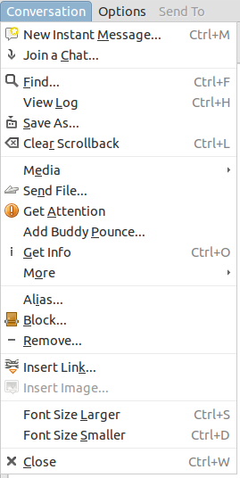
After

Slide 46
EIS vs AIS
EIS:
AIS:
gtkconv.c (Line 3106)
GtkItemFactoryEntry menu_items[]

Slide 47
Estimated Time vs. Actual Time
Estimated Time: 2 minutes
Actual Time: 2 minutes
Similar to a previous fix: text size shortcut

Slide 48
Tests
Checking if the shortcut is added under “conversation” in the toolbar.
Using the key to see if the chat history log pops up.

Slide 49
Thank You
We hope you enjoyed the presentation.
If you’ve got questions/comments/concerns, now is the time to ask them to us.
Thank you for your time.
Have a great summer everyone.

